Slide 1

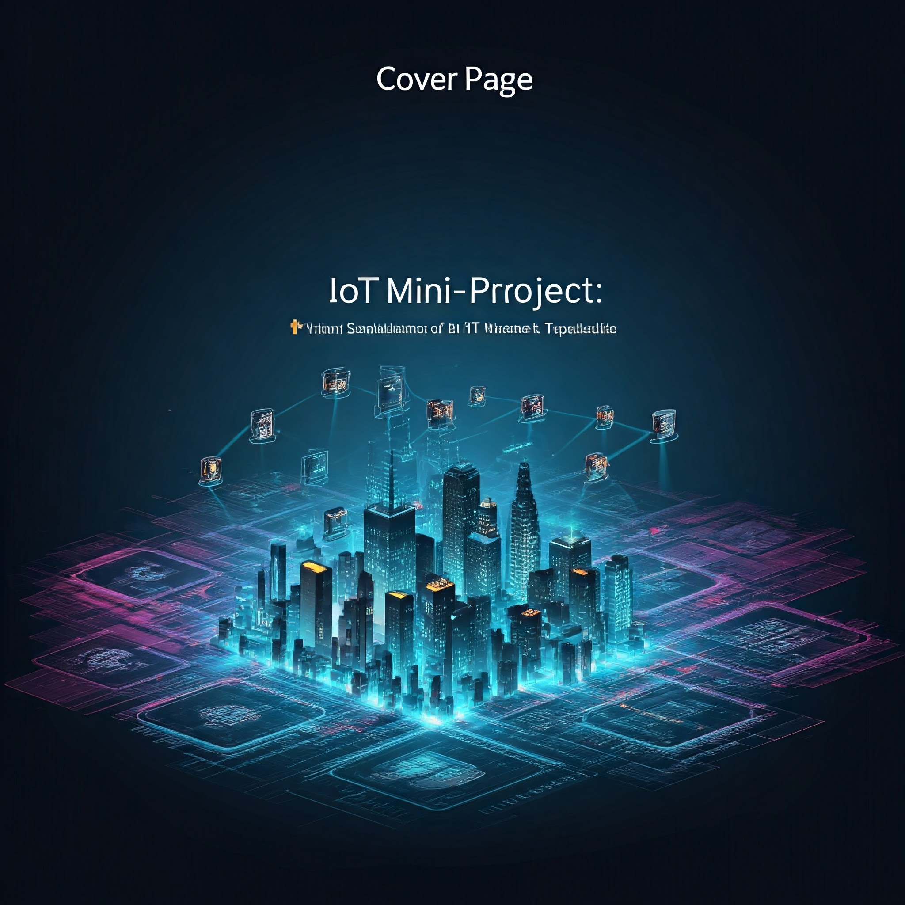
SUBJECT: INTERNET OF THINGS:
PROJECT TITLE:
MINI-PROJECT-1: PYTHON SIMULATIONS OF IOT NETWORK TOPOLOGIES
SIMULATING IOT NETWORK TOPOLOGIES USING PYTHON
PRESENTED BY: PRAMODH NARAIN
CHANNEL: PRAMODH CODE CRAFTER
DATE: 19-10-2024

Slide 2

ACKNOWLEDGMENT
I would like to extend my sincere thanks to my amazing faculty of the subject “Internet of Things”, whose guidance and support made this project possible.
I also wish to express my gratitude to the department of CSE in my college, for providing the resources and knowledge necessary for the completion of this mini-project.
Finally, I appreciate the efforts of my peers and colleagues for their invaluable feedback and encouragement throughout the process

Slide 3
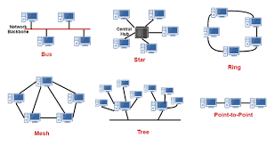
INTRODUCTION
introduction
Network Topology: Arrangement of nodes in a network.
Critical for IoT Systems to ensure efficient data communication.
Objective: Simulate and compare different IoT topologies using Python.

Slide 4
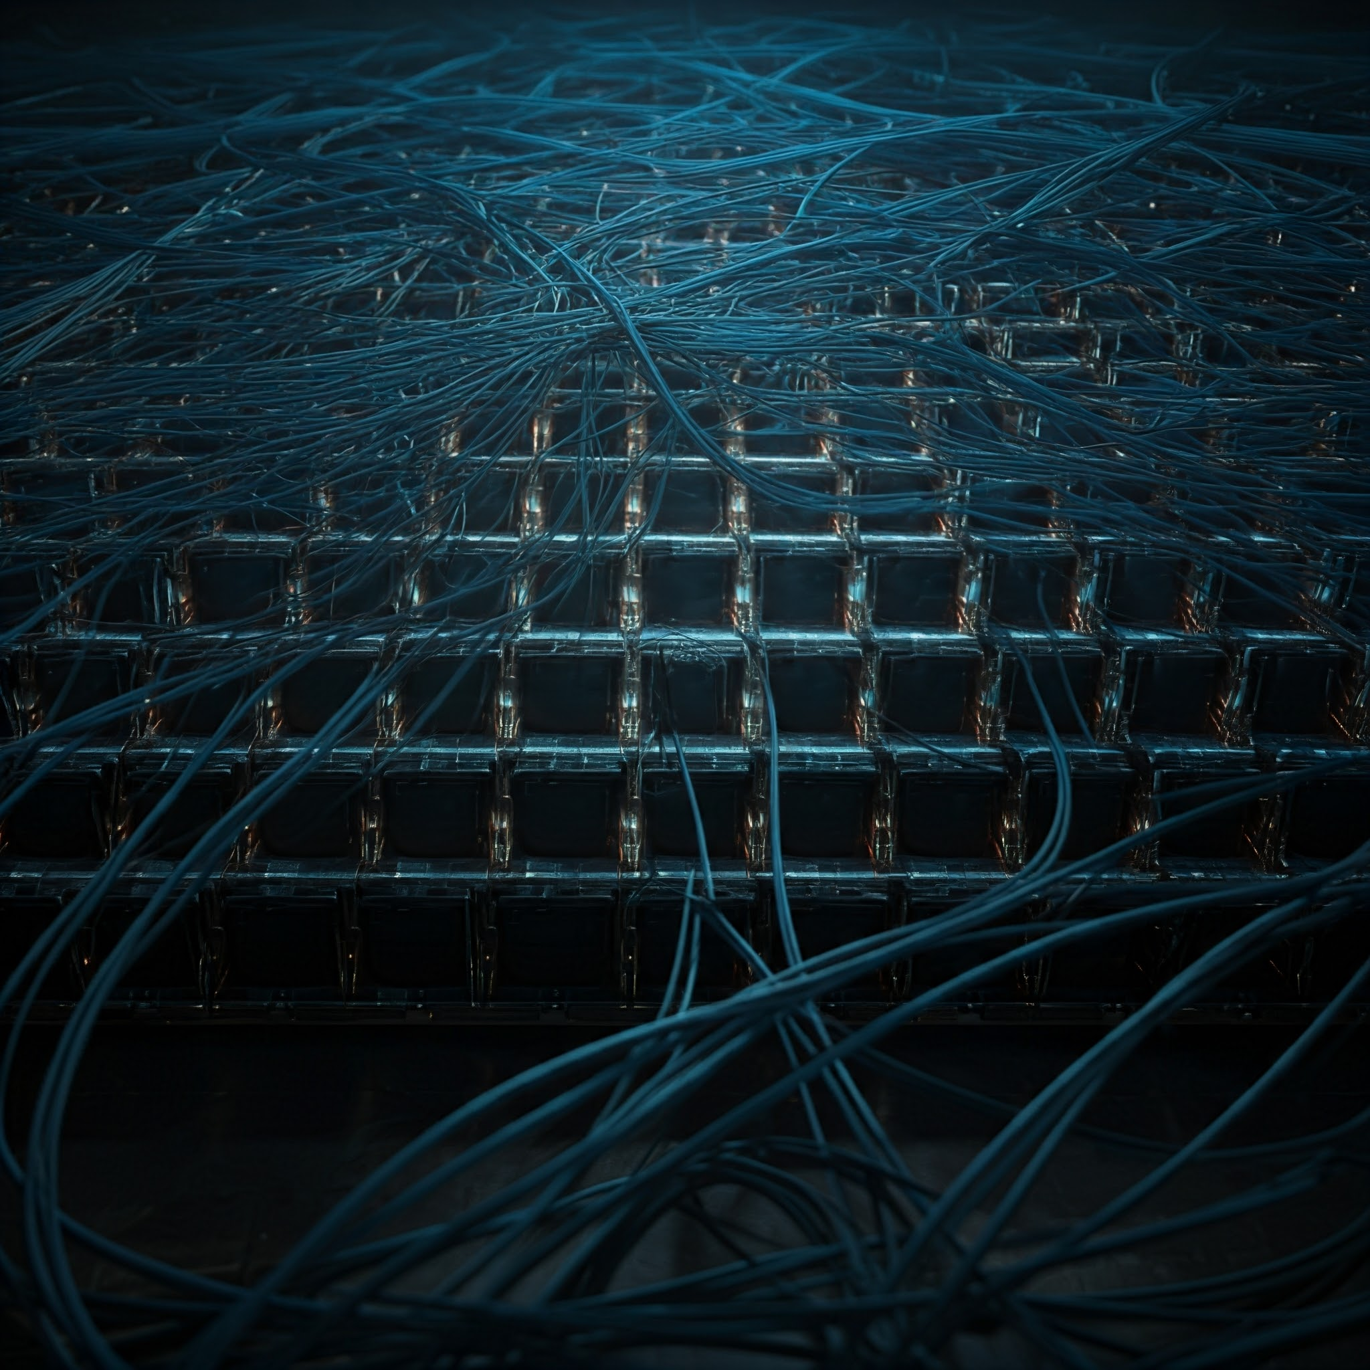
OBJECTIVES
The main objectives of our IoT mini project 1 are mentioned as follows:
Simulate different IoT Network Topologies.
Visualize each topology using Python libraries.
Analyse their efficiency, reliability, and fault tolerance.

Slide 5
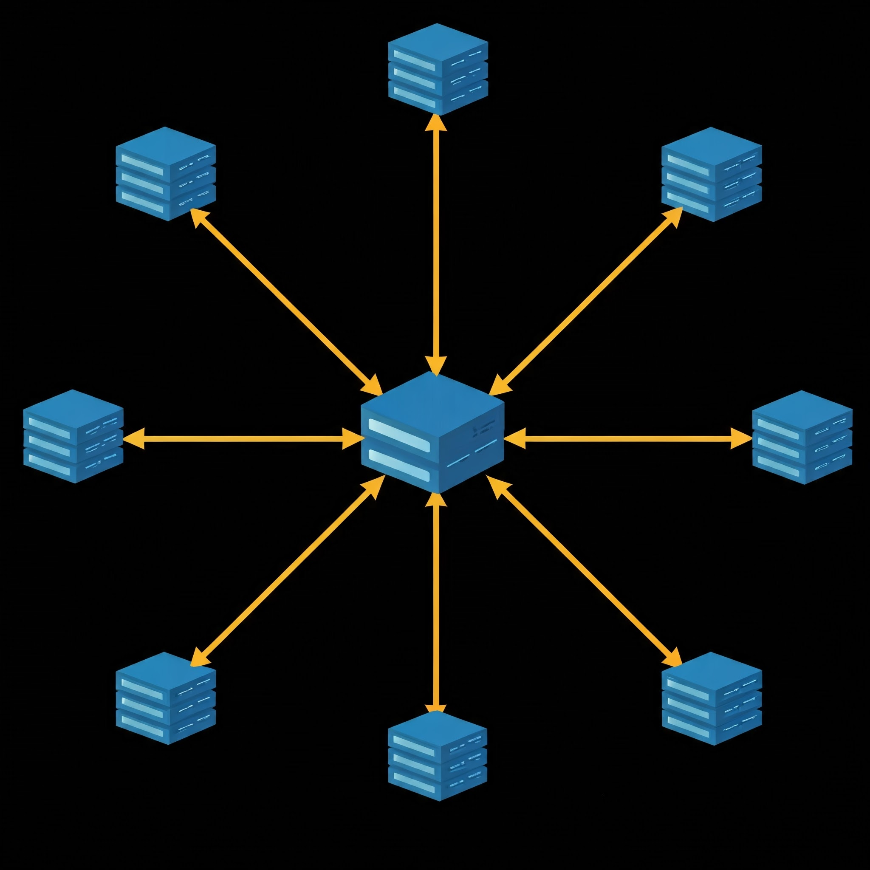
A. STAR TOPOLOGY
TOPOLOGY TYPE: STAR TOPOLOGY:
Description:
Central hub connects all nodes.
Easy to maintain but has a single point of failure.
Applications:
Home Automation: Smart lights, thermostats, etc.
Healthcare IoT: Centralized patient monitoring.

Slide 6
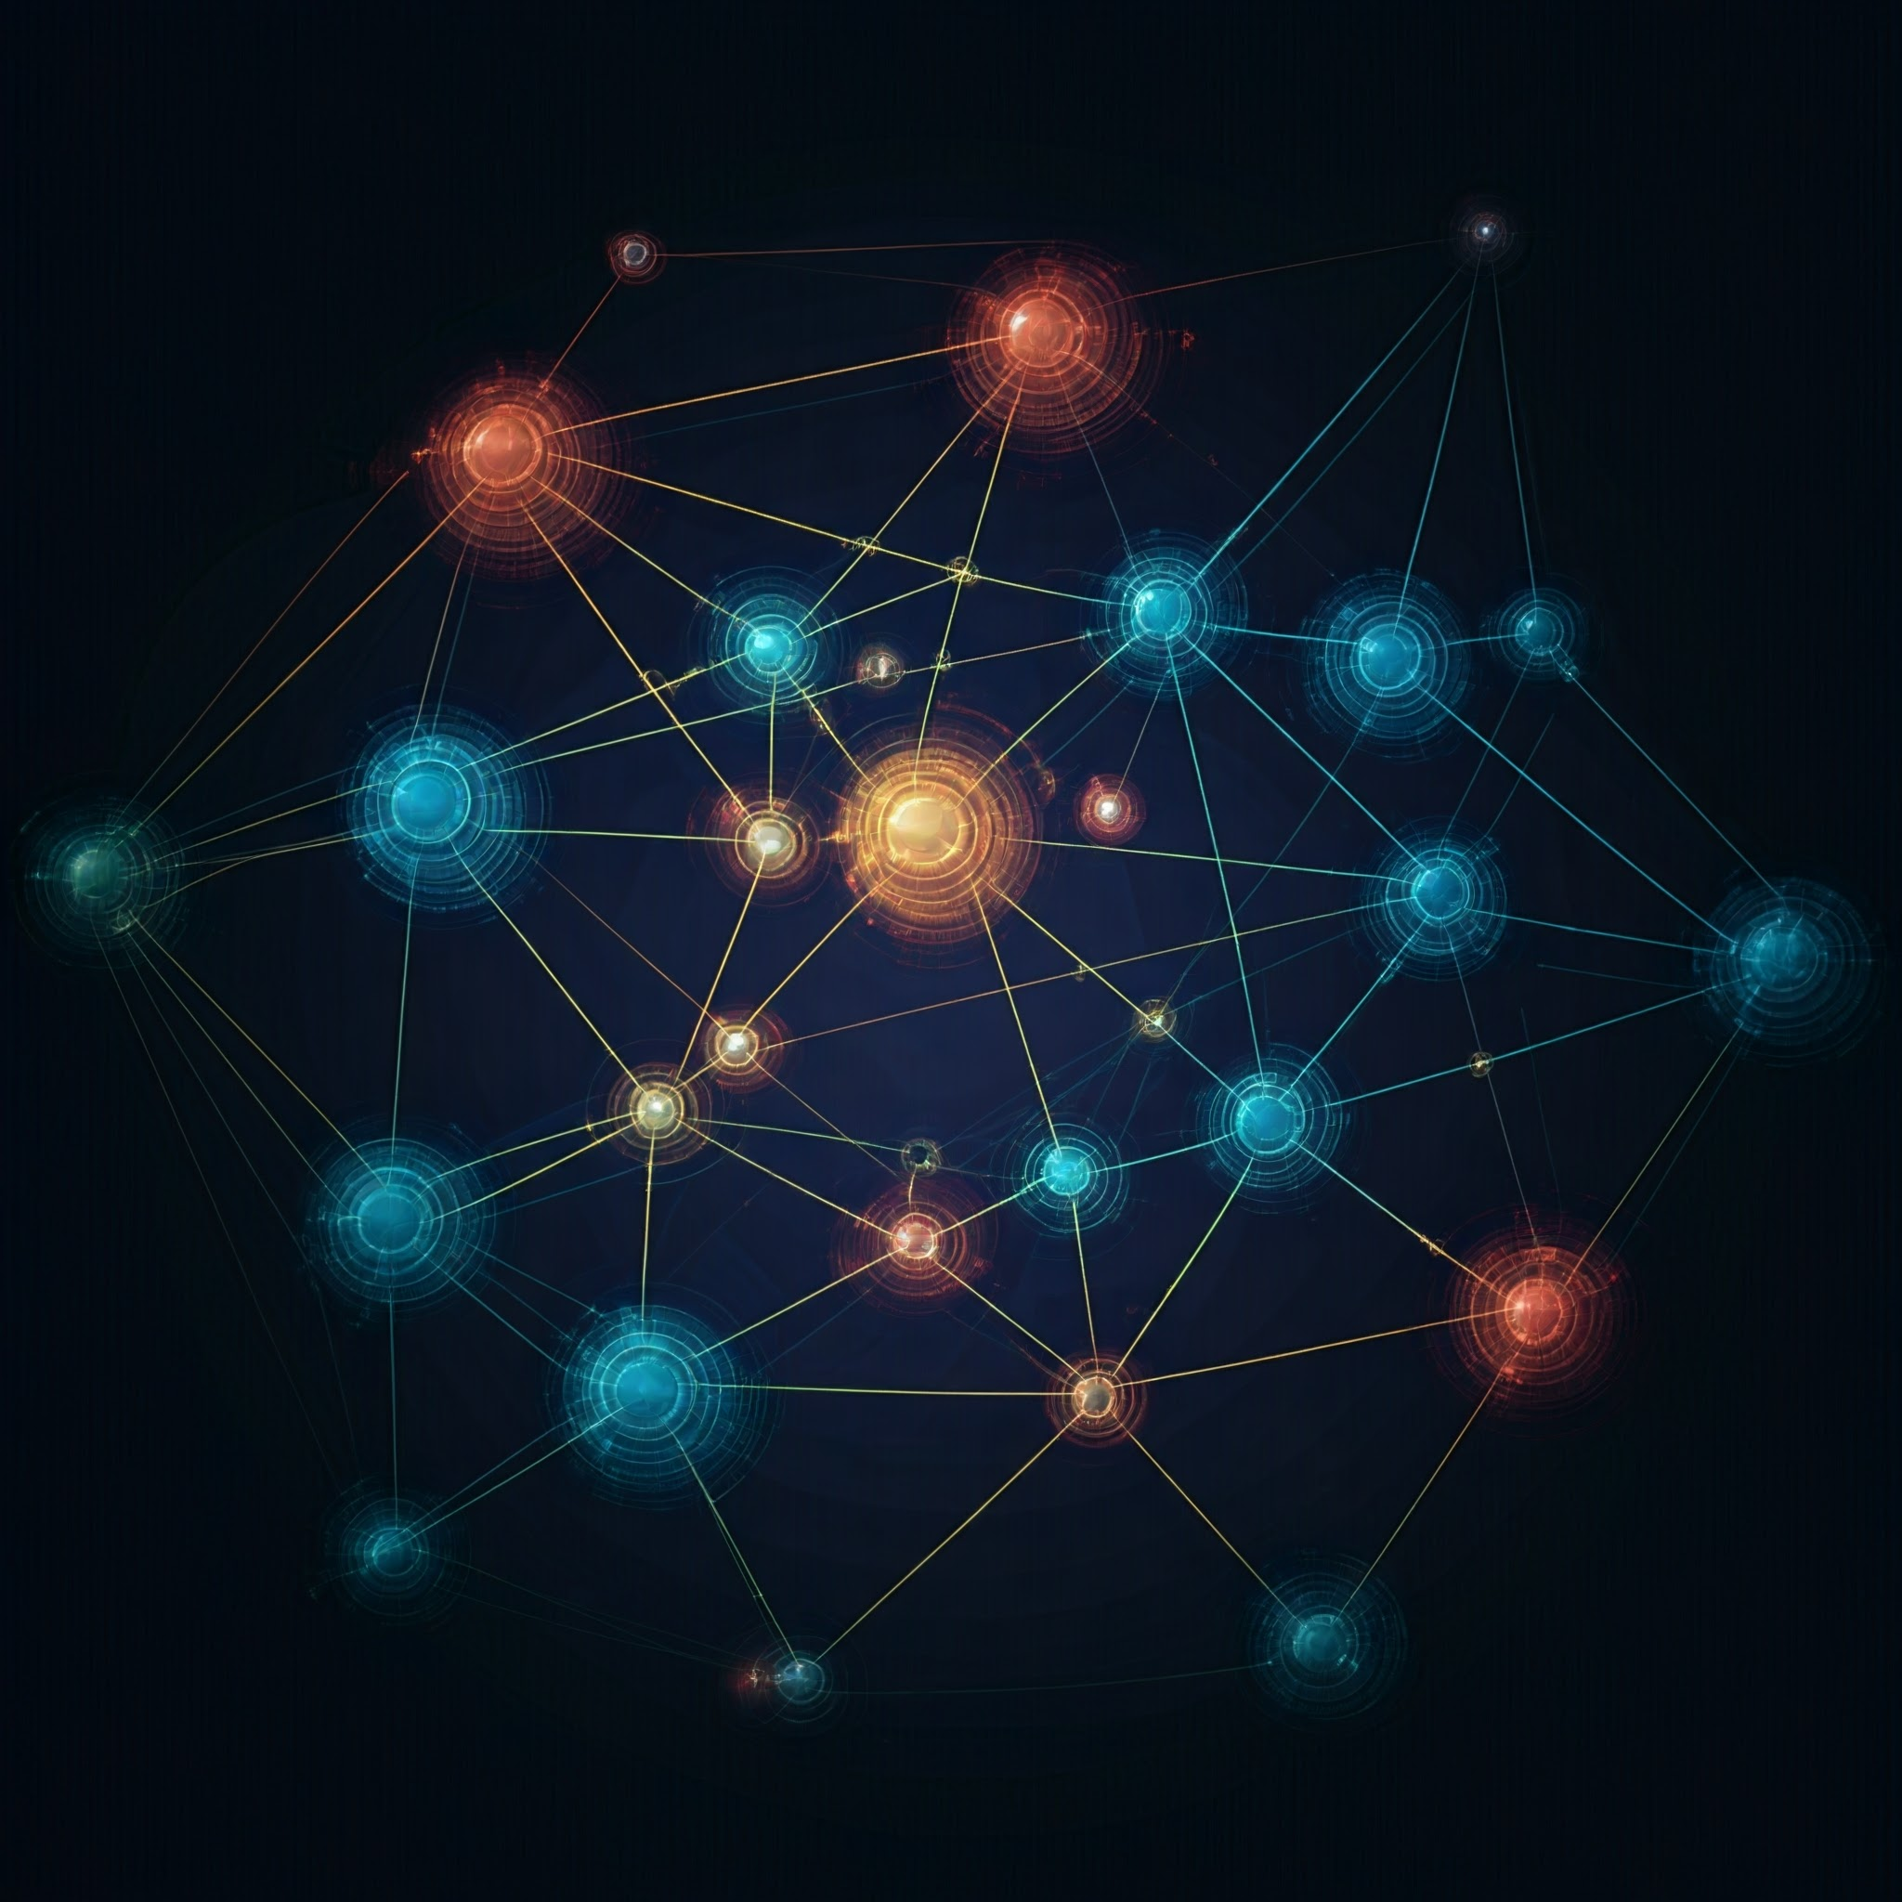
B. MESH TOPOLOGY
TOPOLOGY TYPE: MESH TOPOLOGY:
Description:
Hierarchical structure, each node connects to a parent/child.
Scalable but relies on intermediary nodes.
Applications:
Corporate networks: Departments organized in levels.
Smart Agriculture: Sensors collecting data for precision farming.

Slide 7
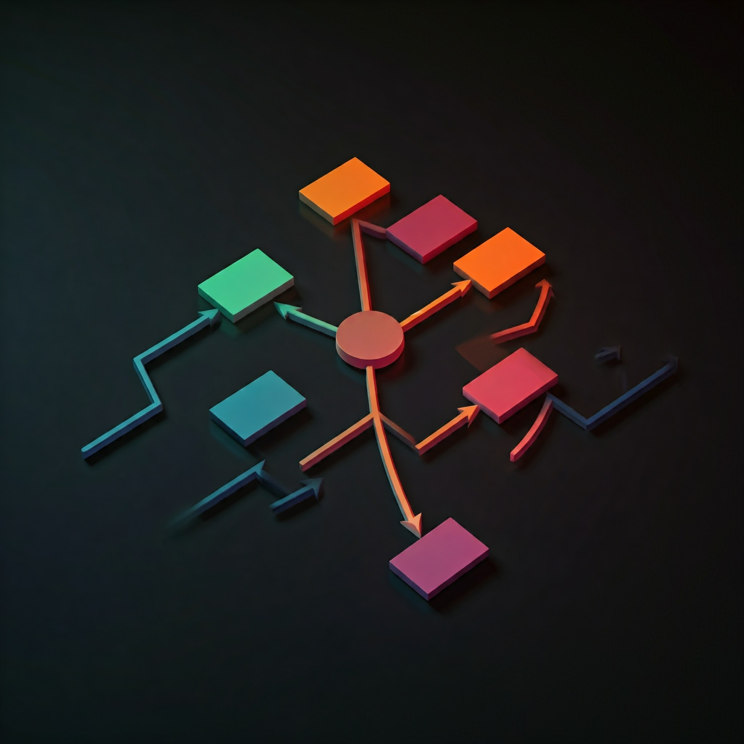
C. TREE TOPOLOGY
TOPOLOGY TYPE: TREE TOPOLOGY:
Description:
Hierarchical structure, each node connects to a parent/child.
Scalable but relies on intermediary nodes.
Applications:
Corporate networks: Departments organized levels.
Smart Agriculture: Sensors collecting data for precision farming.

Slide 8
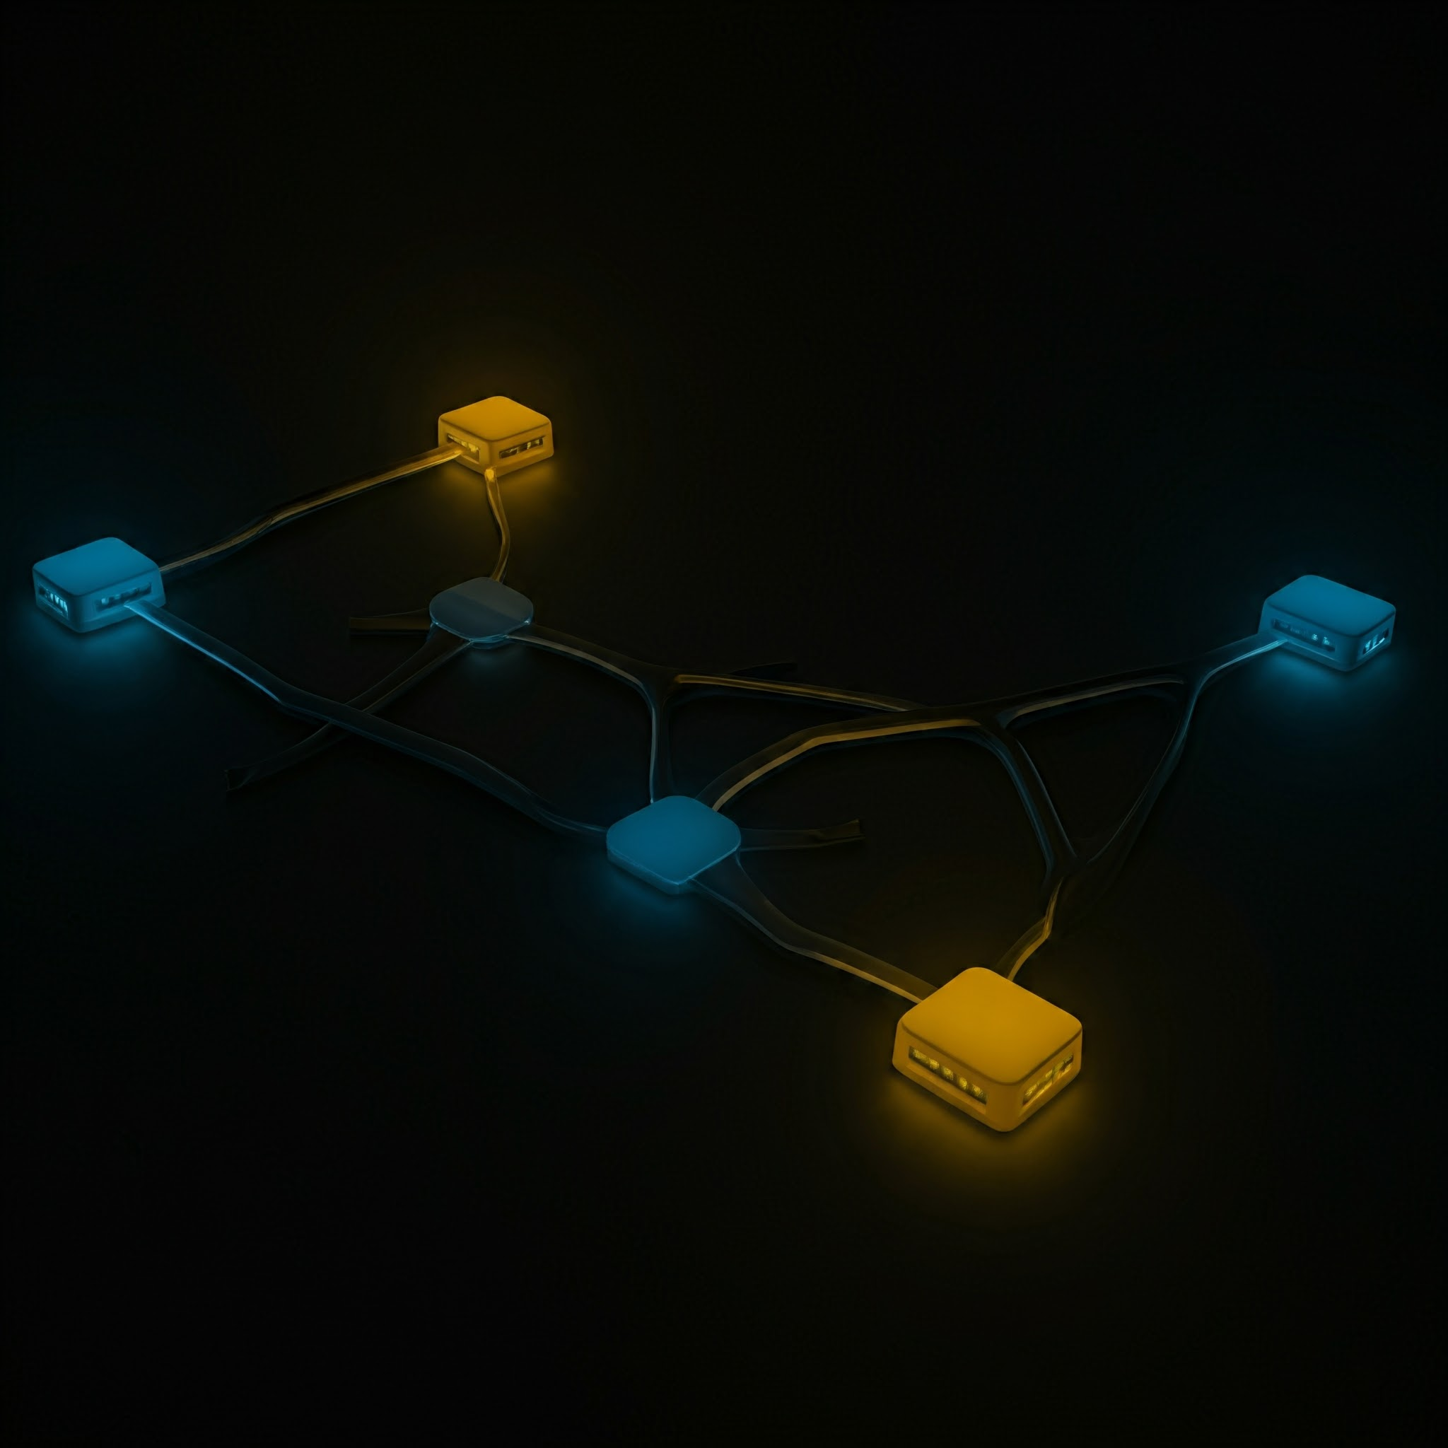
D. bus TOPOLOGY
TOPOLOGY TYPE: BUS TOPOLOGY:
Description:
All nodes share a single communication line.
Simple and cost-effective, but prone to collisions.
Applications:
Vehicle IoT networks: Sensor systems sharing data.
Home IoT networks: Basic communication lines.

Slide 9

E. RING TOPOLOGY
TOPOLOGY TYPE: RING TOPOLOGY:
Description:
Circular connection, data moves in one direction.
Fault in one node breaks the network unless dual-ring is used.
Applications:
City surveillance networks: Cameras and sensors.
Industrial systems: Monitoring pipelines and grids.

Slide 10
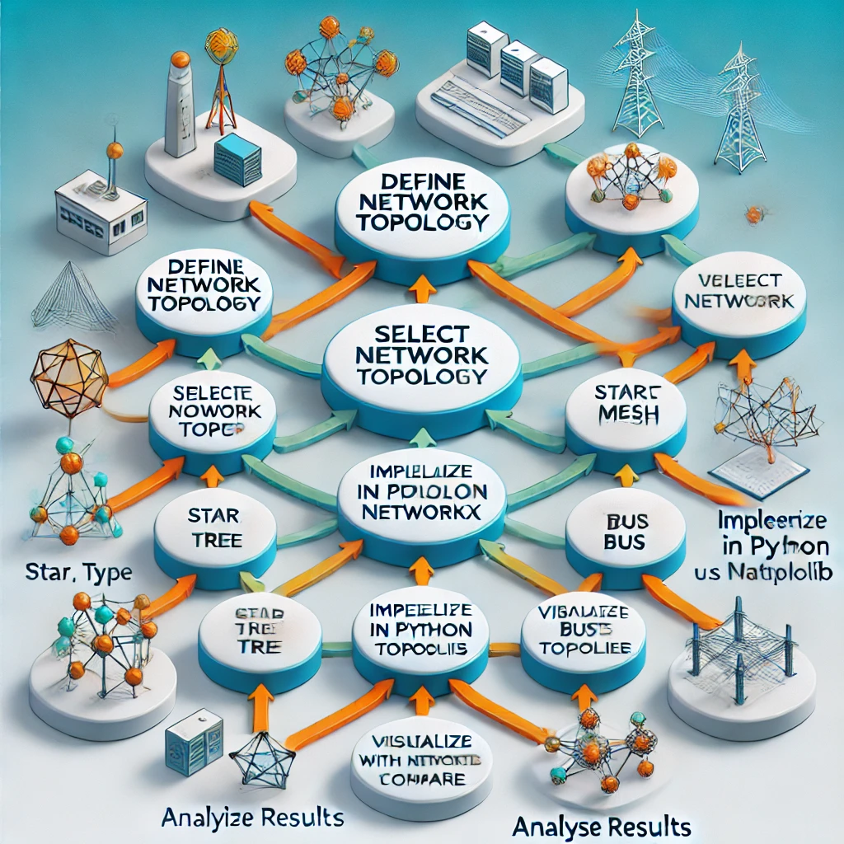
FLOWCHART OF OUR PROJECT

Slide 11
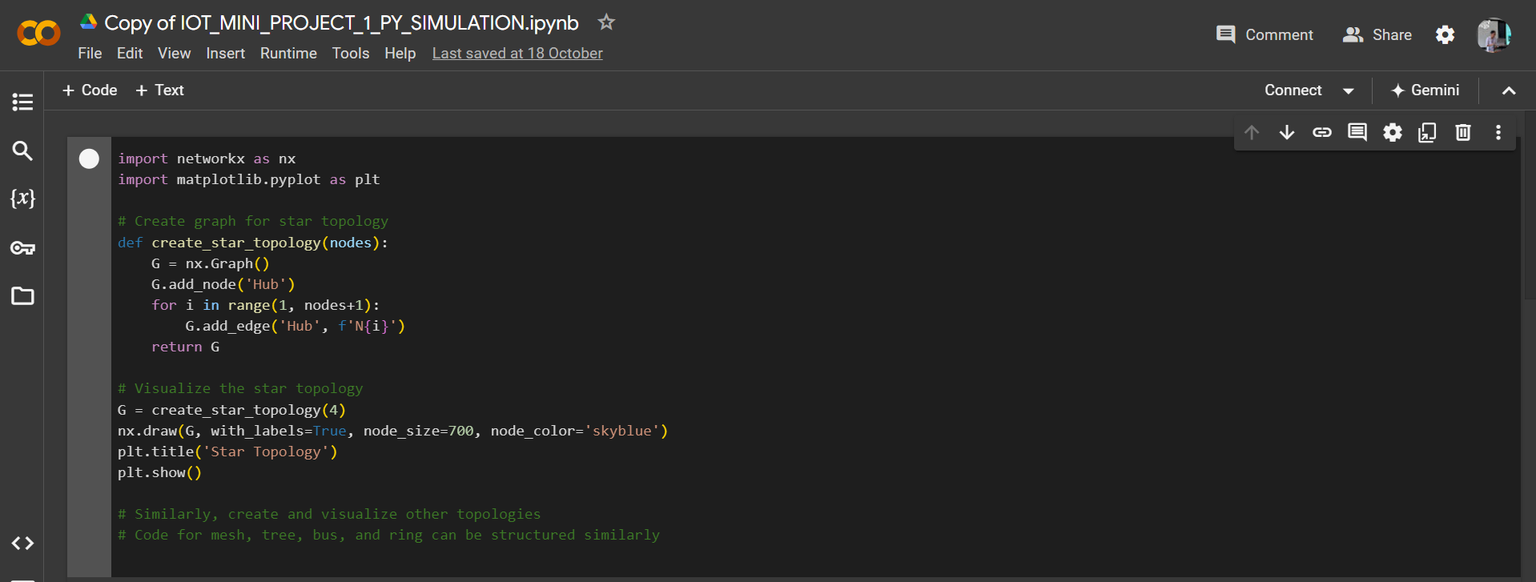
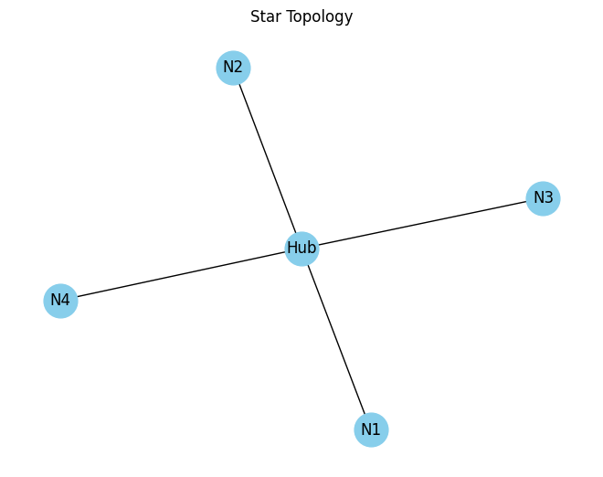
PYTHON CODE OVERVIEW
EXAMPLE: Creating and visualising a Star Topology.
Uses NetworkX for network simulations, Matplotlib for visualizations.

Slide 12
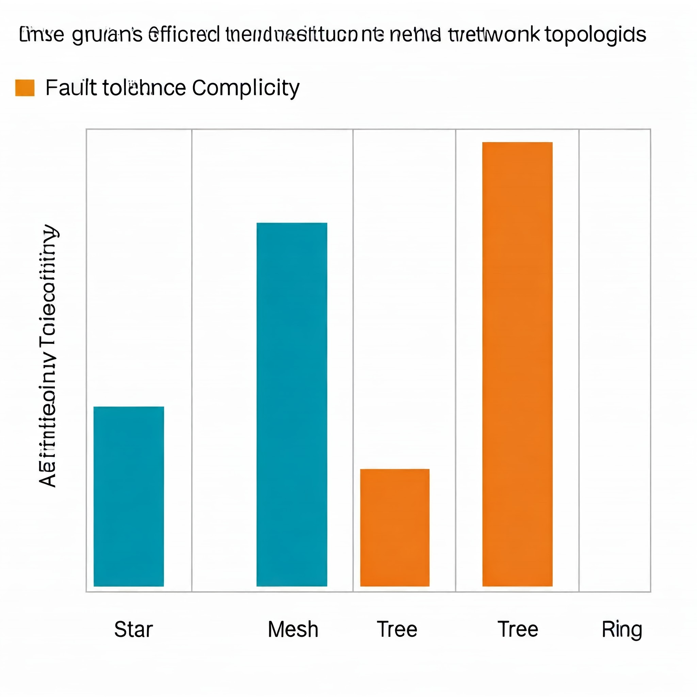
RESULTS AND DISCUSSIONS
STAR TOPOLOGY: Efficient but hub failure critical.
MESH TOPOLOGY: Excellent fault tolerance, high complexity.
TREE TOPOLOGY: Scalable, reliant on parent nodes.
BUS TOPOLOGY: Simple, prone to collisions.
RING TOPOLOGY: Consistent performance, vulnerable to node failure.

Slide 13
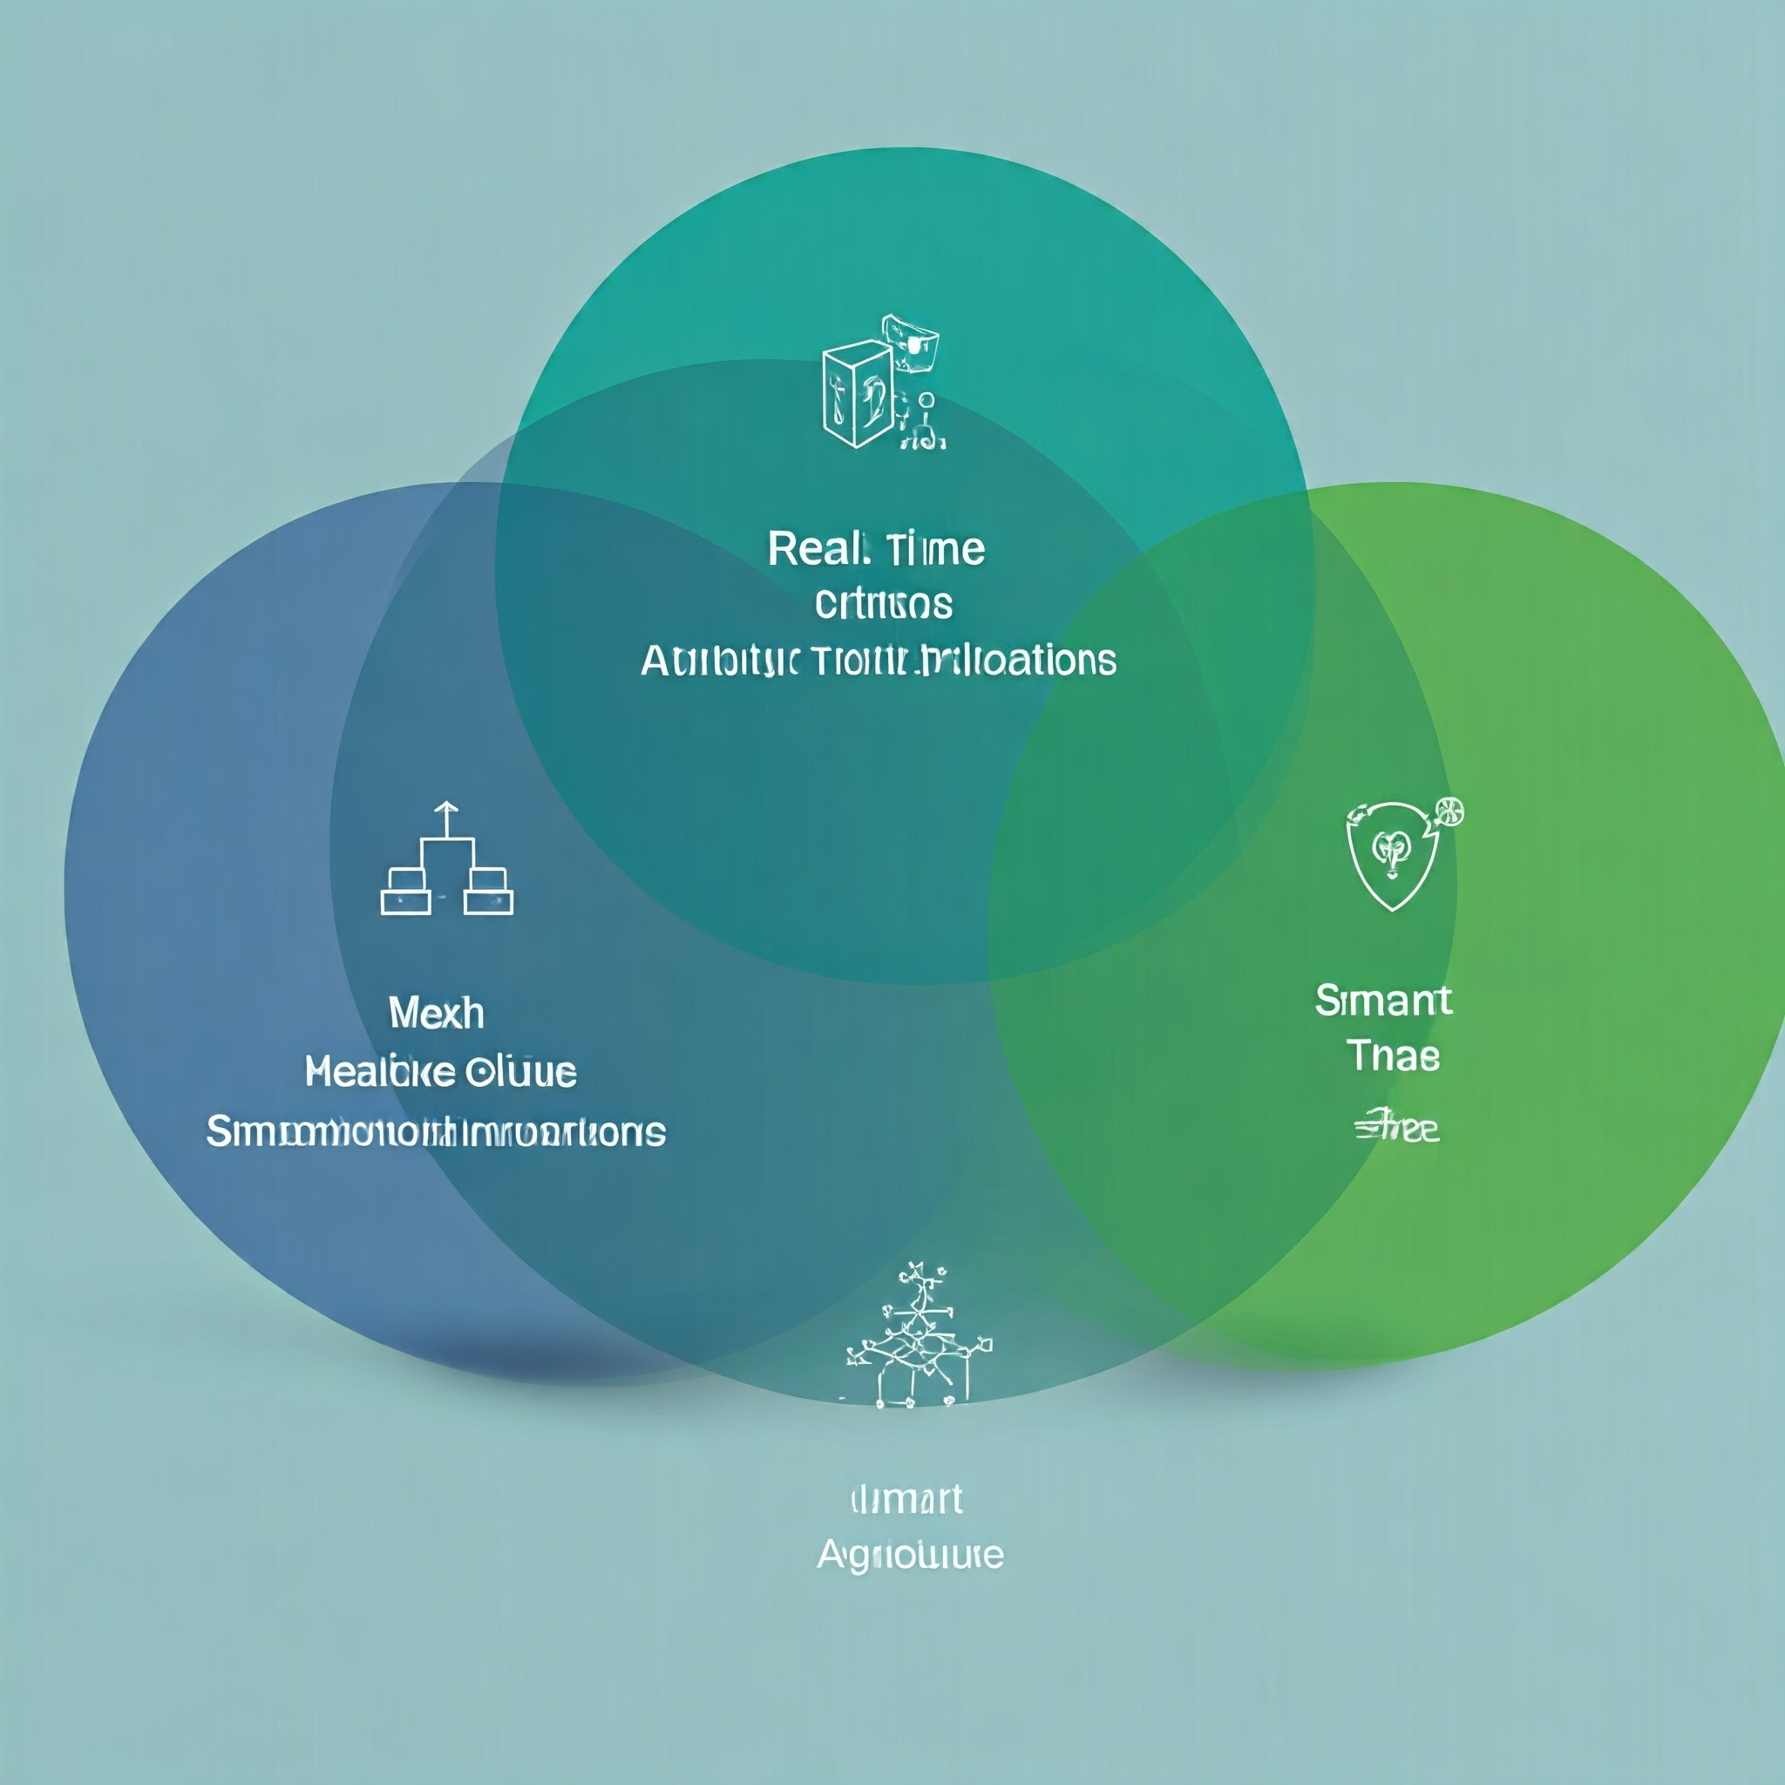
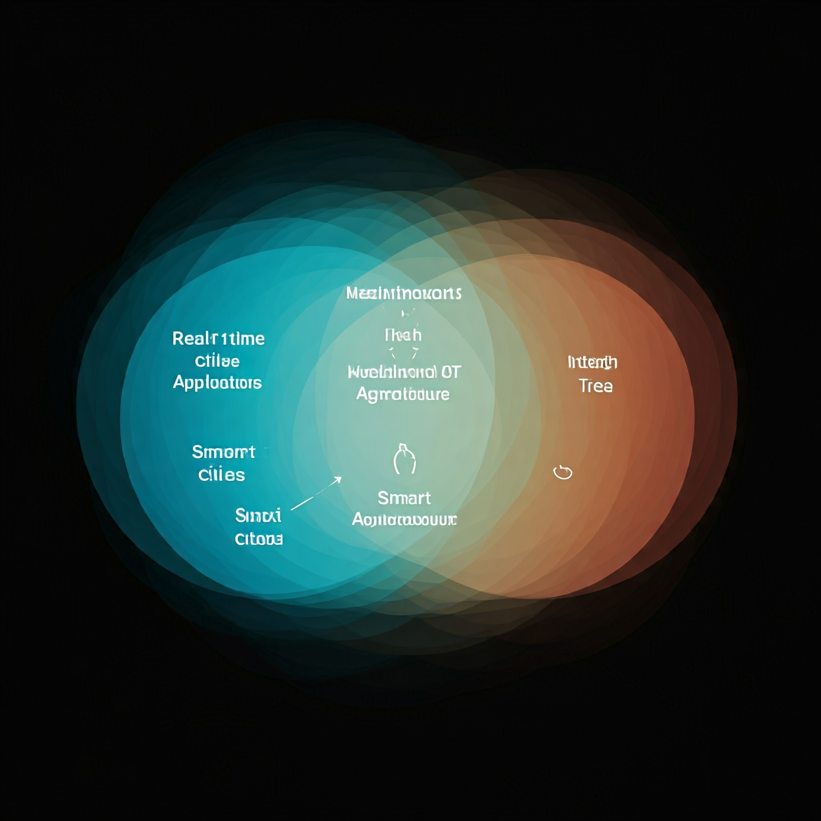
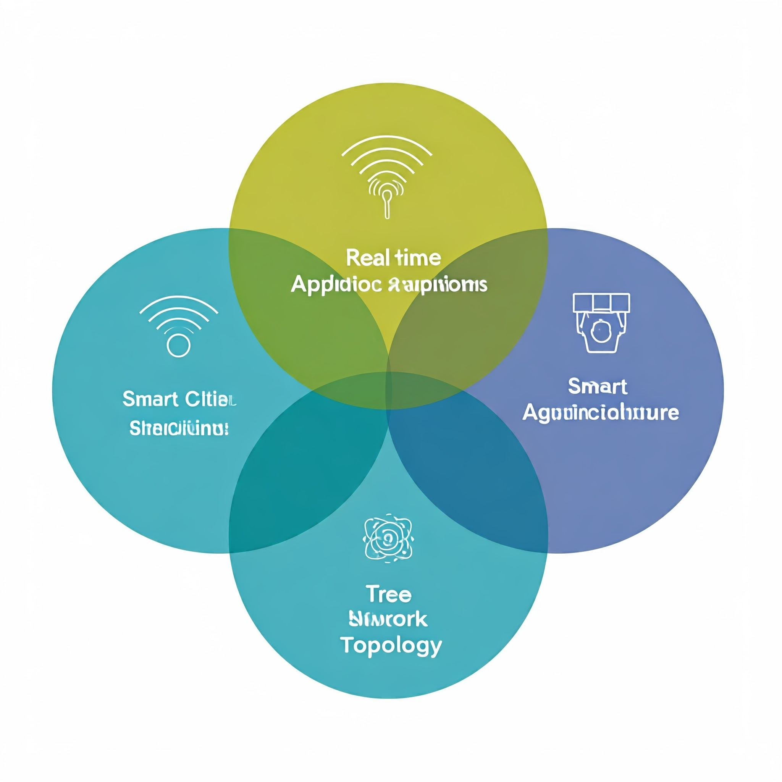
REAL-TIME APPLICATIONS
SMART CITIES: Mesh topology for smart grids, traffic systems.
HEALTHCARE IOT: Star topology for centralized device management.
SMART AGRICULTURE: Tree topology for sensor-based decision-making.

Slide 14
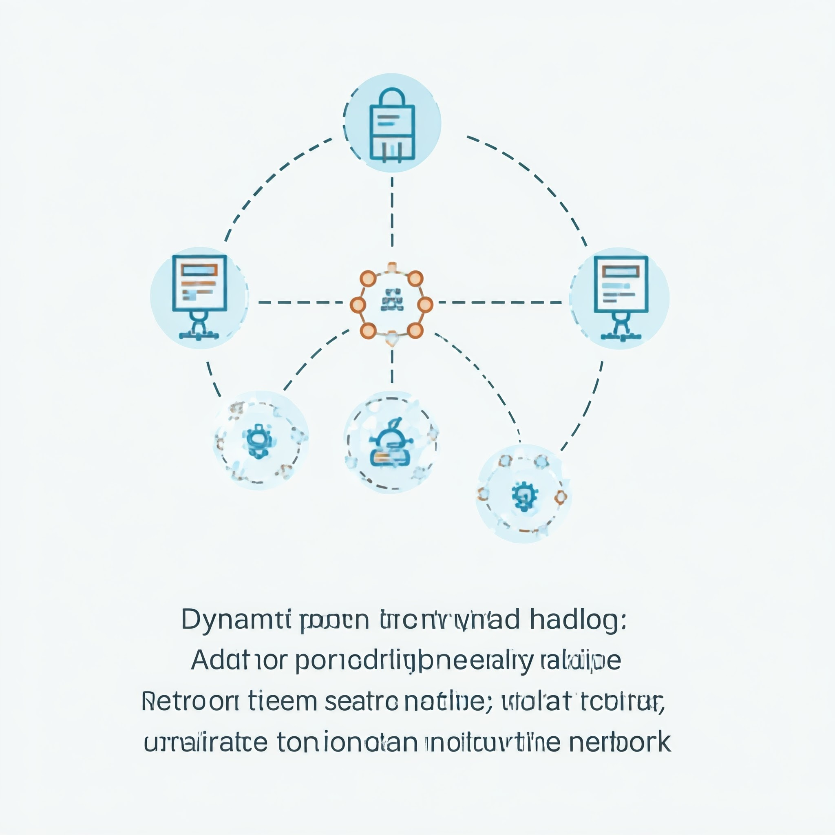
FUTURE IMPLEMENTATIONS
DYNAMIC NODE HANDLING: Add/remove nodes without disrupting the network.
HYBRID NETWORKS: Combine topologies for enhanced performance.
EDGE COMPUTING: Process data closer to where it’s generated.
SECURITY: Implement robust security protocols.

Slide 15
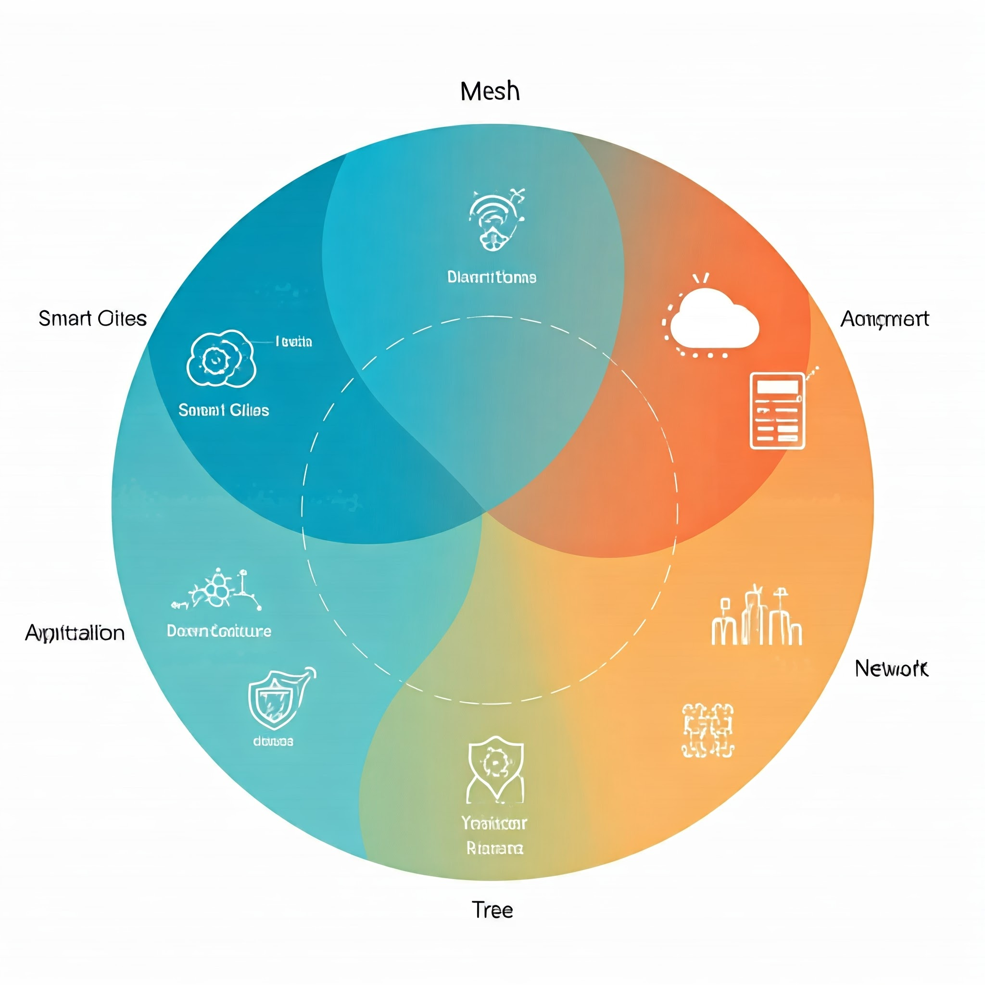
CONCLUSION
Simulated and visualized multiple IoT topologies.
Identified strengths and limitations of each topology.
Potential for future developments to optimize IoT networks.

Slide 16

THANK YOU GUYS!!!
ANY QUESTIONS?
DON’T HESITATE!!
ASK THEM AND I WILL CLARIFY IT FOR YOU PEOPLE!!!
YOU CAN CONTACT ME THROUGH THE COMMENTS SECTION OF THIS YOUTUBE VIDEO.
YOURS SINCERELY
PRAMODH CODE CRAFTER

